Slide 1

CSCE 222 Discrete Structures
Introduction
Dr. Tim McGuire
Grateful acknowledgement to Professor Bart Selman, Cornell University, and Prof. Johnnie Baker, Kent State, for some of the material upon which these notes are adapted.

Slide 2

Textbook
Discrete Mathematics and Its Applications by Kenneth H. Rosen
Use lecture notes as study guide.

Slide 3
Syllabus Review

Slide 4
What is CSCE 222 about?
Continuous vs. Discrete Math
Why is it computer science?
Mathematical techniques for Discrete Structures

Slide 5
So why do I need to learn all this nasty mathematics?
Computation is something that you can’t see and can’t touch, and yet (thanks to the efforts of generations of hardware engineers) it obeys strict, well-defined rules with astonishing accuracy over long periods of time.
Computations are too big for you to comprehend all at once. Imagine printing out an execution trace that showed every operation a typical $500 laptop computer executed in one (1) second. If you could read one operation per second, for eight hours every day, you would die of old age before you got halfway through. Now, imagine letting the computer run overnight.

Slide 6
So why do I need to learn all this nasty mathematics?
So in order to understand computations, we need a language that allows us to reason about things we can’t see and can’t touch, that are too big or us to understand, but that nonetheless follow strict, simple, well-defined rules.
We’d like our reasoning to be consistent: any two people using the language should obtain the same conclusions from the same information.
That language is mathematics.

Slide 7
Discrete vs. Continuous Mathematics
Continuous Mathematics: It considers objects that vary continuously;
Example: analog wristwatch (separate hour, minute, and second hands).
From an analog watch perspective, between 1 :25 p.m. and 1 :26 p.m. there are infinitely many possible different times as the second hand moves around the watch face.
Real-number system --- core of continuous mathematics;
Continuous mathematics --- models and tools for analyzing real-world phenomena that change smoothly over time. (Differential equations etc.)

Slide 8
Discrete vs. Continuous Mathematics
Discrete Mathematics: It considers objects that vary in a discrete way.
Example: digital wristwatch.
On a digital watch, there are only finitely many possible different times between 1 :25 P.M. and 1:27 P.M. A digital watch does not show split seconds: - no time between 1 :25:03 and 1 :25:04. The watch moves from one time to the next.
Integers --- core of discrete mathematics
Discrete mathematics --- models and tools for analyzing real-world phenomena that change discretely over time and therefore ideal for studying
computer science – computers are digital! (numbers as finite bit strings; data structures, all discrete! Historical aside: earliest computers were analog.)

Slide 9
What is CSCE 222 about?
Why is it computer science? (examples)

Slide 10
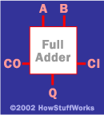
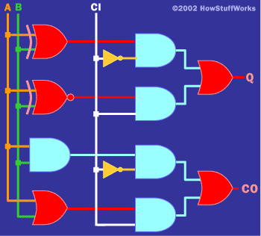
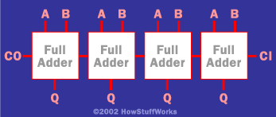
Logic: Hardware and software specifications
Formal: Input_wire_A
value in {0, 1}
Example 1: Adder
One-bit Full Adder with Carry-In and Carry-Out
4-bit full adder
Example 2: System Specification:
The router can send packets to the edge system only if it supports the new address space.
For the router to support the new address space it’s necessary that the latest software release be installed.
The router can send packets to the edge system if the latest software release is installed.
The router does not support the new address space.
How to write these specifications in a rigorous / formal way? Use Logic.

Slide 11
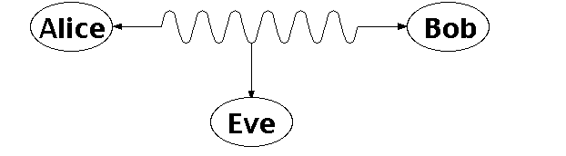
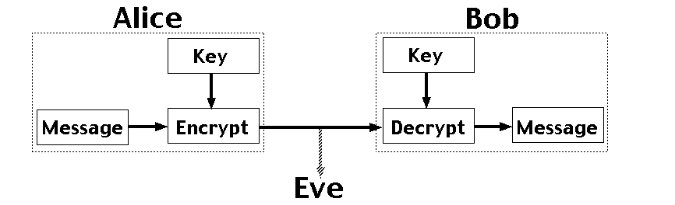
Number Theory: RSA and Public-key Cryptography
Alice and Bob have never met but they would like to exchange a message. Eve would like to eavesdrop.
E.g. between you and the Bank of America.
They could come up with a good encryption algorithm and exchange the encryption key – but how to do it without Eve getting it? (If Eve gets it, all security is lost.)
CS folks found the solution:
public key encryption. Quite remarkable that this is feasible.
Notes:
One solution is for Alice and Bob to exchange a digital key, so they both know it, but it's otherwise secret. Alice uses this key to encrypt messages she sends, and Bob reconstructs the original messages by decrypting with the same key. The encrypted messages (ciphertexts) are useless to Eve, who doesn't know the key, and so can't reconstruct the original messages. With a good encryption algorithm, this scheme can work well, but exchanging the key while keeping it secret from Eve is a problem. This really requires a face to face meeting, which is not always practical.

Slide 12
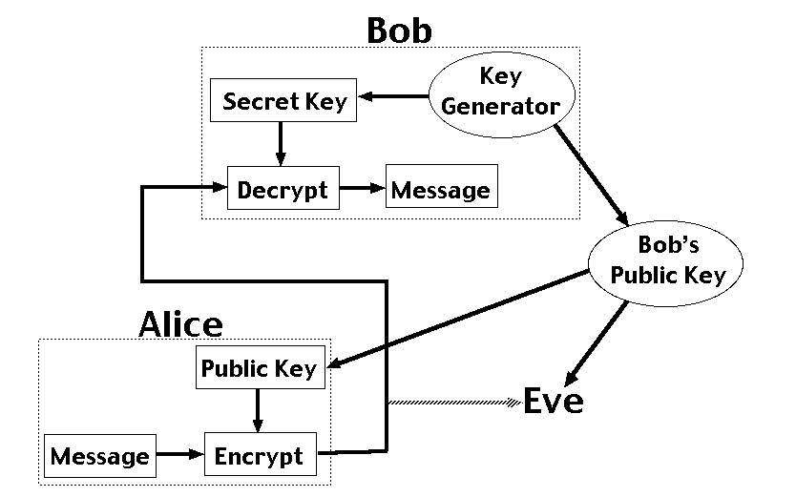
Number Theory: Public Key Encryption
RSA – Public Key Cryptosystem (why RSA?)
Uses modular arithmetic and large primes → Its security comes from the computational difficulty of factoring large numbers.
Notes:
Public key encryption is different, because it splits the key up into a public key for encryption and a secret key for decrpytion. It's not possible to determine the secret key from the public key. In the diagram, Bob generates a pair of keys and tells everybody (including Eve) his public key, while only he knows his secret key. Anyone can use Bob's public key to send him an encrypted message, but only Bob knows the secret key to decrypt it. This scheme allows Alice and Bob to communicate in secret without having to meet.
RSA rivest, shamir and adleman

Slide 13
RSA Approach
Encode:
C = Me (mod n)
M is the plaintext; C is ciphertext
n = pq with p and q large primes (e.g. 200 digits long!)
e is relative prime to (p-1)(q-1)
Decode:
C^{d} = M (mod pq)
d is inverse of e modulo (p-1)(q-1)
The process of encrypting and decrypting a message correctly results in the original message (and it’s fast!)

Slide 14
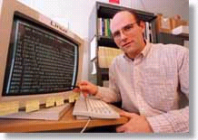
Automated Proofs:
EQP (Equation Prover) - Robbin’s Algebras are all Boolean
A mathematical conjecture (Robbins conjecture) unsolved for decades. First non-trivial mathematical theorem proved automatically.
The Robbins problem was to determine whether one particular set of rules is powerful enough to capture all of the laws of Boolean algebra. One way to state the Robbins problem in mathematical terms is:
Can the equation not(not(P))=P be derived from the following three equations?
[1] P or Q = Q or P,
[2] (P or Q) or R = P or (Q or R),
[3] not(not(P or Q) or not(P or not(Q))) = P.
[An Argonne lab program] has come up with a major mathematical
proof that would have been called creative if a human had thought of it.
New York Times, December, 1996
https://www.cs.unm.edu/~mccune/papers/robbins/

Slide 15
Graph Theory

Slide 16
Graphs and Networks
Many problems can be represented by a graphical network representation.
Examples:
Distribution problems
Routing problems
Maximum flow problems
Designing computer / phone / road networks
Equipment replacement
And of course the Internet
Aside: finding the right problem representation is one of the key issues.

Slide 17
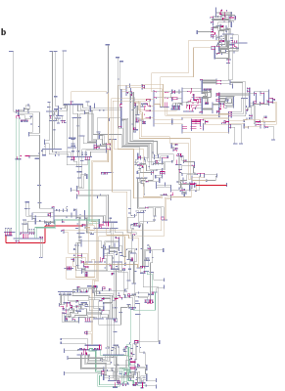
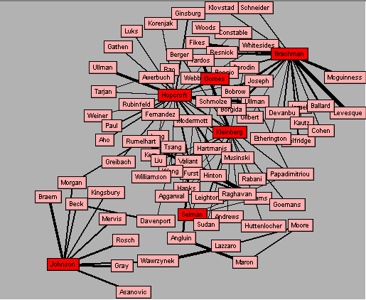
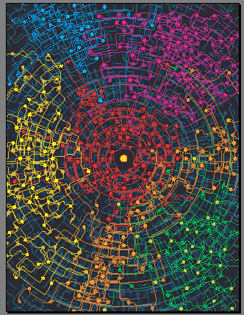
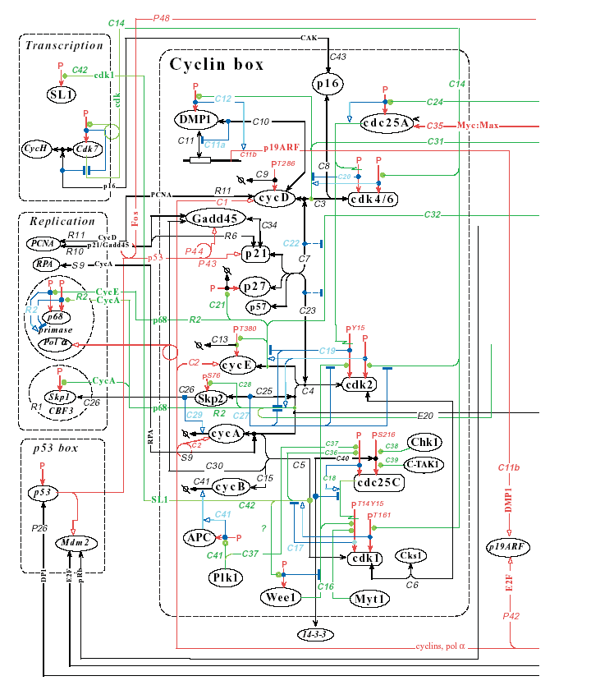
New Science of Networks
Networks are pervasive
Utility Patent network
1972-1999
(3 Million patents)
Gomes,Hopcroft,Lesser,Selman
Neural network of the
nematode worm C- elegans
(Strogatz, Watts)
NYS Electric Power Grid
(Thorp,Strogatz,Watts)
Network of computer scientists
ReferralWeb System
(Kautz and Selman)
Cybercommunities
(Automatically discovered)
Kleinberg et al
Notes:
Networked or linked structures are ubiquitous. Examples range from the World Wide Web, large social networks such as the network of board of directors or the network of Hollywood actors, the distribution network of Wal-Mart, the power grid of the US, or even the neurological network of our brain.
August 96 - Major power outage that affected the entire west coast of the US from Alaska to California for over 24 hours.
This power outage was caused by a single transmission line, that was knocked down by a tree. More interestingly, the accident was detected right away and as standard procedure the load of the line was transferred to the other lines of the set; but they were already overloaded and the extra overload caused the lines to heat up and stretch. Well, this was a hot summer, the trees had grown dramatically and a few lines were knocked down, causing the domino effect that brought down the entire power grid of the west coast of the US.
How did it happened? Key issues:
How can we design more robust networks?
How does disease spread in a network of people?
Graphs that occur in many biological, social, and manmade systems are often neither completely regular nor completely random –
Instead they have a small world topology ➔ nodes are highly clustered
And yet the path length between them is small

Slide 18
Applications of Networks
Applications
Physical analog of nodes
Physical analog of arcs
Flow
Communication systems
phone exchanges,
computers,
transmission
facilities, satellites
Cables, fiber optic
links, microwave
relay links
Voice messages, Data, Video transmissions
Hydraulic systems
Pumping stations Reservoirs, Lakes
Pipelines
Water, Gas, Oil, Hydraulic fluids
Integrated computer circuits
Gates, registers, processors
Wires
Electrical current
Mechanical systems
Joints
Rods, Beams, Springs
Heat, Energy
Transportation systems
Intersections, Airports, Rail yards
Highways, Airline routes Railbeds
Passengers,
freight,
vehicles,
operators

Slide 19
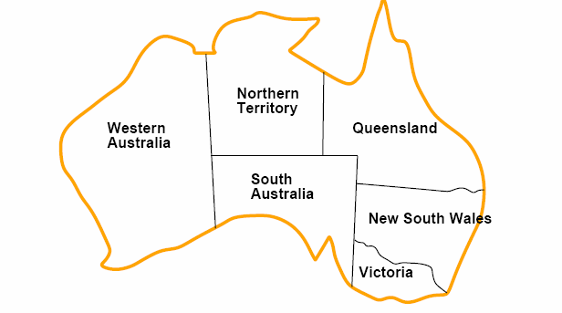
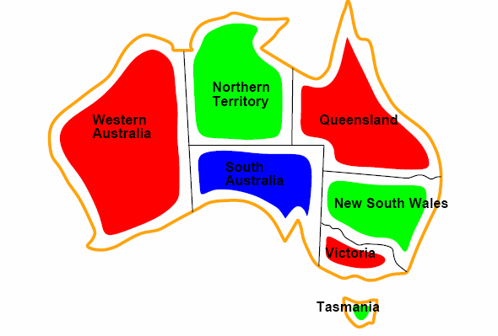

Example: Coloring a Map
How to color this map so that no two adjacent regions have the same color?

Slide 20
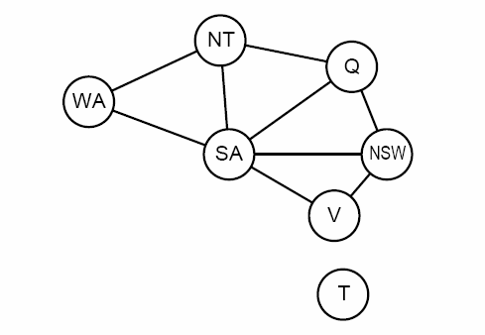
Graph representation
Abstract the
essential info:
Coloring the nodes of the graph:
What’s the minimum number of colors such that any two nodes connected by an edge have different colors?

Slide 21

Four Color Theorem
The chromatic number of a graph is the least number of colors that are required to color a graph.
The Four Color Theorem – the chromatic number of a planar graph is no greater than four. (quite surprising!)
Proof: Appel and Haken 1976; careful case analysis performed by computer; proof reduced the infinitude of possible maps to 1,936 reducible configurations (later reduced to 1,476) which had to be checked one by one by computer.
The computer program ran for hundreds of hours. The first significant computer-assisted mathematical proof.
Write-up was hundreds of pages including code!
Four color map.
How do we know the proof is actually correct?
(later CS folks to the rescue)

Slide 22
Examples of Applications of Graph Coloring

Slide 23
Scheduling of Final Exams
How could the final exams at TAMU be scheduled so that no student has two exams at the same time? (Note not obvious this has anything to do with graphs or graph coloring!)
Graph:
A vertex correspond to a course.
An edge between two vertices denotes that there is at least one common
student in the courses they represent.
Each time slot for a final exam is represented by a different color.
A coloring of the graph corresponds to a valid schedule of the exams.

Slide 24
Scheduling of Final Exams
1
1
Time
Period
I
II
III
IV
Courses
1,6
2
3,5
4,7
2
7
2
7
6
3
6
3
5
4
5
4
Why is mimimum
number of colors
useful?
What are the constraints between courses?
Find a valid coloring

Slide 25
Frequency Assignments
T.V. channels 2 through 13 are assigned to stations in North America so that no two stations within 150 miles can operate on the same channel. How can the assignment of channels be modeled as a graph coloring?
A vertex corresponds to one station
There is a edge between two vertices if they are located within 150 miles of each other
Coloring of graph --- corresponds to a valid assignment of channels; each color represents a different channel.

Slide 26
Index Registers
In efficient compilers the execution of loops can be speeded up by storing frequently used variables temporarily in registers in the central processing unit, instead of the regular memory. For a given loop, how many index registers are needed?
Each vertex corresponds to a variable in the loop.
An edge between two vertices denotes the fact that the corresponding variables must be stored in registers at the same time during the execution of the loop.
Chromatic number of the graph gives the number of index registers needed.

Slide 27
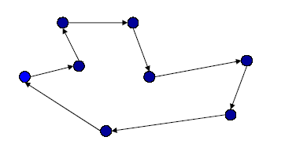
Example 2: Traveling Salesman
Find a closed tour of minimum length visiting all the cities.
TSP → lots of applications:
Transportation related: scheduling deliveries
Many others: e.g., Scheduling of a machine to drill holes in a circuit board ;
Genome sequencing; etc

Slide 28
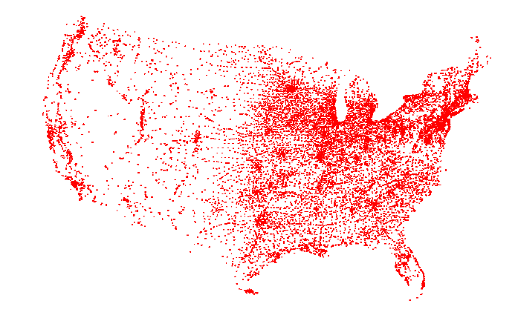
13,509 cities in the US (with populations > 500)
13508!= 1.4759774188460148199751342753208e+49936

Slide 29
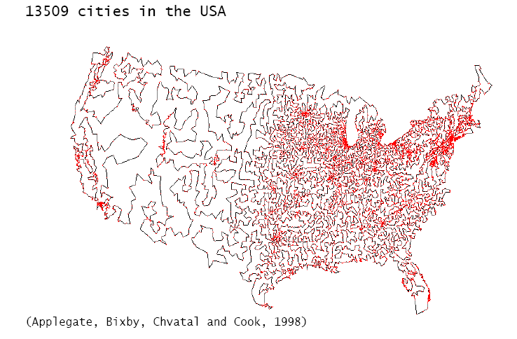
The optimal tour!

Slide 30
Probability and Chance
Importance of concepts from probability is rapidly increasing in CS:
Randomized algorithms (e.g. primality testing; randomized search algorithms, such as simulated annealing, Google’s PageRank, “just” a random walk on the web!) In computation, having a few random bits really helps!
Machine Learning / Data Mining: Find statistical regularities in large amounts of data. (e.g. Naïve Bayes alg.)
Natural language understanding: dealing with the ambiguity of language (words have multiple meanings, sentences have multiple parsings --- key: find the most likely (i.e., most probable) coherent interpretation of a sentence (the “holy grail” of NLU).

Slide 31
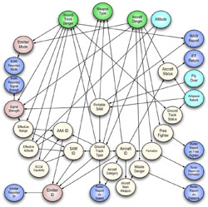
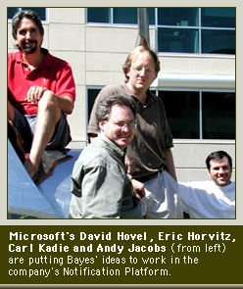
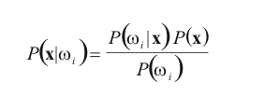
Probability: Bayesian Reasoning
Bayesian networks provide a means of expressing joint probability over many interrelated hypotheses and therefore reason about them.
Example of Query:
what is the most likely diagnosis for the infection given all the symptoms?
Bayesian networks have been successfully applied in diverse fields such as medical diagnosis, image recognition, language understanding, search algorithms, and many others.
Bayes Rule
“18th-century theory is new force in computing” CNET ’07

Slide 32
Probability and Chance, cont.
Back to checking proofs...
Imagine a mathematical proof that is several thousands pages long. (e.g., the classification of so-called finite simple groups, also called the enormous theorem, 5000+ pages).
How would you check it to make sure it’s correct? Hmm…

Slide 33
Probability and Chance, cont.
Computer scientists have recently found a remarkable way to do this:
“holographic proofs”
Ask the author of the proof to write it down in a special encoding (size increases to, say, 50,000 pages of 0 / 1 bits). You don’t need to see the encoding! Instead, you ask the author to give you the values of 50 randomly picked bits of the proof. (i.e., “spot check the proof”).
With almost absolute certainty, you can now determine whether the proof is correct of not! (works also for 100 trillion page proofs, use eg 100 bits.) Aside: Do professors ever use “spot checking”?
Started with results from the early nineties (Arora et al. ‘92) with recent refinements (Dinur ’06). Combines ideas from coding theory, probability, algebra, computation, and graph theory. It’s an example of one of the latest advances in discrete mathematics. See Bernard Chazelle, Nature ’07.

Slide 34
Course Themes, Goals, and Course Outline

Slide 35
Goals of CSCE 222
Introduce students to a range of mathematical tools from discrete mathematics that are key in computer science
Mathematical Sophistication
How to write statements rigorously
How to read and write theorems, lemmas, etc.
How to write rigorous proofs
Areas we will cover:
Logic and proofs
Set Theory
Induction and Recursion
Counting and combinatorics
Probability theory
Number Theory (if time permits)
Practice works!
Actually, only practice works!
Note: Learning to do proofs from
watching the lecture is like trying to
learn to play tennis from watching
it on TV! So, do the exercises!
Aside: We’re not after the shortest or most elegant proofs;
verbose but rigorous is just fine! ☺

Slide 36
Topics CSCE 222
Logic and Methods of Proof
Propositional Logic --- SAT as an encoding language!
Predicates and Quantifiers
Methods of Proofs Sets
Sets and Set operations
Functions
Counting
Basics of counting
Pigeonhole principle
Permutations and Combinations Number Theory (if time permits)
Modular arithmetic
RSA cryptosystems

Slide 37
Topics CSCE 222
Probability
Probability Axioms, events, random variable
Independence, expectation, example distributions
Birthday paradox
Monte Carlo method
Graphs and Trees (light coverage if time permits. Covered in Data Structures and Algorithms)
Graph terminology
Example of graph problems and algorithms:
graph coloring
TSP
shortest path

Slide 38
The END

